Slide 2
fetal arrhythmias ,fetal tachycardia and bradycardia
Dr. azam faraji
Perinatalogist at SUMS

Slide 3
Baseline Fetal Heart Rate
maturation of conduction system of fetal heart in 16 weeks
rate between 110 and 160 bpm
baseline FHR during a 10 minute segment
Excluding periodic changes
differentiated from prolonged acceleration or deceleration
Changes in FHR exceed 10 min in duration to be a new baseline
baseline must be identifiable for 2 minutes during the interval (but not necessarily a contiguous 2 minutes)

Slide 4
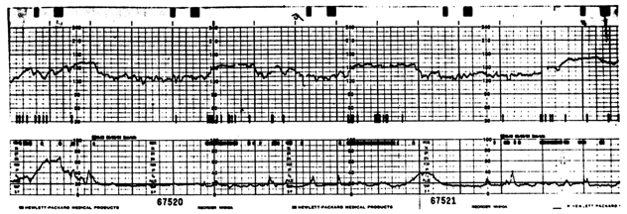
Baseline Fetal Heart Rate

Slide 5
most fetal arrhythmias are isolated findings
structural or functional heart disease in10 percent of fetuses with tachycardia and 50 percent in bradycardia
aliasing at 240 bpm limits its ability to track the most rapid tachycardias and very transient arrhythmias

Slide 6
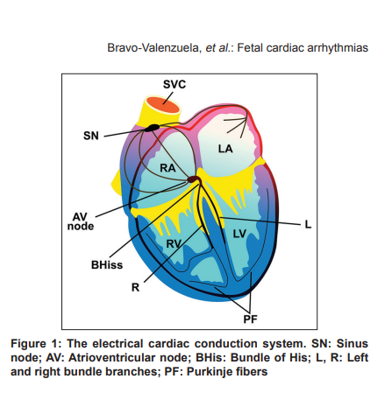

Slide 7
IRREGULAR RHYTHMS Fetal arrhythmias in 1% to 3% of all pregnancies extrasystoles are the most common cause
intermittently Irregular rhythms well tolerated
Persistent ectopy or ectopy of ventricular origin or Irregular rhythms due to conduction abnormalities have concern

Slide 8
Irregular Heart Rate
Premature atrial contractions (PACs) are the result of nonsinus atrial depolarization
1% to 3% of all pregnancies
associated with illicit drug use, trisomy 18, and hyperthyroidism
Rarely, are trigger of sustained SVT
Fetal PACs ,early atrial wall movement (M-mode), mitral inflow (Doppler) pattern, or inferior vena cava flow (Doppler) pattern.

Slide 9
Management Options
Isolated PACs require no treatment
recurrent auscultation of FHR due to association with SVT until the ectopic beats resolve.
Frequent, blocked PACs (e.g., fetal bigeminy) may appear to be a fetal bradycardia
avoid caffeine and β-adrenergic drugs (e.g., terbutaline) ,excess amount of calcium containing foods (milk products).

Slide 10
Premature Ventricular Contractions
caused by early, nonsinus depolarization of the ventricles
PVCs produce a characteristic Doppler flow pattern with absence of diastolic flow across the AV (mitral) valve prior to the initiation of ventricular systole (aortic outflow)
They account for approximately 2% to 4% of all fetal ectopy
Management Options PVCs are benign and avoidance of cardiac stimulants such as caffein

Slide 11
TACHYARRHYTHMIAS (FHR >160 bpm)
Differential diagnosis includes:
Sinus tachycardia
Supraventricular tachycardia (SVT): Typical 1:1 reentrant tachycardia
Atrial flutter, 2:1 conduction with atrial rates of 400 to 440 bpm and ventricular rates of 200 to 220 bpm
Automatic mechanisms (eg, ectopic atrial tachycardia, junctional ectopic tachycardia, and atrial fibrillation)
Ventricular tachycardia

Slide 12
sinus tachycardia (160 to 200 bpm)
Diagnosis
Atrial rates of 160 to 200 bpm or 210
1:1 atrioventricular conduction
Normal duration of the atrioventricular interval
At least some heart rate variability

Slide 13
It is important to distinguish between significant fetal tachycardia and an arrhythmia, especially when the heart rate is ≥ 200 bpm.
A sinus tachycardia is more likely to have developed gradually from a slower baseline
Usually does not$>200 bmp but occasionaly is$
BBV diminish at rapid heart rate because withdrawal of vagal tone
as opposed to the usual abrupt onset of an arrhythmia.
Fetal echocardiography is helpful for diagnosis of specific arrhythimia.

Slide 15
The key feature to distinguish fetal compromise in association with tachycardia seems to be concomitant heart rate decelerations (tachycardia + deceleration )
Short bursts of sinus tachycardia (typically up to 200 bpm) associated with fetal movement are normal in late pregnancy and do not require cardiac evaluation
In the presence of good variability tachycardia is not a sign of fetal distress

Slide 18
Management of persistent sinus tachycardia involves recognition and treatment of the underlying cause
may be a marker of
early fetal hypoxia
elevated maternal catecholamine levels due to anxiety or pain
maternal fever
Thyrotoxicosis
intra-amniotic infection
fetal anemia
maternal medications (antihistamines with anticholinergic activity eg, diphenhydramine ,Certain drug parasympatholytic :atropine and
hydroxyzine or sympathomimetic: terbutaline in PLP)
maternal hypotension caused by epidural analgesia

Slide 19
Maternal laboratory testing
nonstress test or biophysical profile
fetal ultrasound examination
Doppler measurement of fetal middle cerebral arterial peak systolic velocity when clinically appropriate

Slide 20
Diagnosis and differential diagnosis
leakage of fluid or uterine tenderness ⇾ intrauterine infection.
Thyroid function tests, CBC with differential,
samples for culture and sensitivity, and a urine toxicology screen may be indicated.
A comprehensive fetal anatomic survey with particular attention of the heart
assessment for pericardial, pleural, ascitic and subcutaneous fluid
Amniotic fluid volume , as oligohydramnios may indicate membrane rupture while polyhydramnios is often associated with congestive heart failure

Slide 21
A detailed fetal echocardiogram
In addition to standard two-dimensional imaging and color flow mapping, M-mode and pulsed Doppler are critical for the characterization of a fetal arrhythmia.

Slide 22
Management
Antepartum
maternal hyperthyroidism ⇾ antithyroid
medications such as methimazole.
Antibiotics for maternal systemic infections
acetaminophen : short-term to reduce maternal fever
drugs with sinus tachycardia D/C
chorioamnionitis ⇾ delivery
left lateral tilt, hydration and pain control have been explored.

Slide 23
Intrapartum
Regardless of whether the cause of the tachycardia is extrinsic or intrinsic to the fetus, persistent fetal tachycardia during the intrapartum period limits the ability to monitor the fetal response to labor to ensure fetal well-being.
New-onset fetal tachycardia in labor may indicate intrauterine infection or fetal acidemia, so prompt evaluation, judicious interventions and timely delivery is indicated.

Slide 24
fetal blood sampling (FBS) if feasible to do so in labour
unresolved maternal conditions causing fetal sinus tachycardia or unsuccessfully treated require cesarean delivery
unless nonintervention is planned due to a coexisting cardiac malformation.
A trial of labor with vaginal delivery can be considered in cases with spontaneous or medically-induced conversion to normal sinus rhythm.
neonatologists and pediatric cardiologists experienced in the management of tachyarrhythmias should be available

Slide 25
supraventricular tachycardia
SVT is most common fetal tachycardia, up to 90 percent of cases
Diagnosis
regular rate between 220 and 260 bpm rarely up to 300 bpm
sustained for hours or days but more commonly is intermittent
The fetal monitoring tracing dose not distinguish between atrial flutter and other supraventricular tachycardias.
Echocardiography is most conclusive in differentiating between atrial flutter and other varieties of supraventricular tachycardia.

Slide 26
Baseline Information:
two heart rates are seen.
The upper is either marked tachycardia, as seen with tachyarrhythmia, or double counting.
The lower rate is either half counting a true fetal heart rate or the maternal heart rate.
There is no reactivity. Variability appears decreased despite external monitoring.

Slide 28
Clinical findings
Early echocardiographic signs of hemodynamic compromise include biatrial enlargement and atrioventricular valve regurgitation
Later findings include cardiomegaly and decreased systolic function, ultimately resulting in nonimmune hydrops fetalis
Outcome
The mortality rate of hydropic fetuses with SVT is over 50 percent
maternal therapy results in cardioversion in 65 to 95 percent of cases within 48 hours to one week

Slide 29
Influence of gestational age
≥37 weeks
the primary decision revolves around where and how to deliver the newborn
There is rarely a reason to pursue transplacental drug therapy
Hydrops can be the exception

Slide 30
30 to 36 weeks
transplacental drug therapy
The risks of Mirror syndrome and preeclampsia are likely increased and could be an indication for delivery
<30 week
transplacental therapy

Slide 31
SVT with rates between 200 and 220 bpm at presentation and no hydrops
Refer to a fetal cardiologist for accurate diagnosis and assessment
not immediate intervention or hospitalization.
With good function and fetal wellbeing frequent checks of heart rate and ventricular function is recomended
weekly evaluation by the cardiologist and two FHR checks per week by the obstetric provider
daily maternal monitoring of fetal movement

Slide 32
SVT with persistent rate >220 bpm at presentation and no hydrops
refer to a fetal cardiologist for evaluation of fetal cardiac function, anatomy, and mechanism of SVT
if structural anomalies are present, the postnatal management and prognosis of these anomalies effect on the timing of delivery and/or the aggressiveness of maternal therapy

Slide 33
fHRs >220 bpm are likely to progress to hydrops
admit the mother and FHR monitoring for 24 hours for amount of time of tachycardic
If SVT is present >50 percent of the time, then maternal treatment is typically initiated in fetuses <37weeks
at term (≥37 weeks), delivery with postnatal treatment of arrhythmia considere

Slide 34
svt in <25 percent of the time, weekly FHR determination, ultrasound evaluation for hydrops fetalis, and reevaluation by the fetal cardiologist
If it persists at a low rate and the fetus remains well, the frequency of visits can be reduced
SVT between 25 and 50 percent , twice-weekly FHR determination and ultrasound evaluation and weekly reevaluation by the fetal cardiologist

Slide 35
Persistent SVT (any rate) at presentation and hydrops fetalis
treatment of hydropic fetuses, regardless of the amount of time the fetus is in SVT
≥37 weeks of gestation, a short trial of an effective agent (eg, flecainide, sotalol, or digoxin) for 48 to 72 hours, with aggressive dosing to obtain adequate fetal drug levels rather than delivery
If was ineffective, delivery is recomended

Slide 36
Choice of drug
Transplacental therapy
Most antiarrhythmic drugs are initiated with inpatient maternal monitoring with daily electrocardiograms
For therapies other than digoxin (eg, sotalol, flecainide, amiodarone), continuous cardiac monitoring is the standard practice
In a meta-analysis both flecainide and sotalol were more effective than digoxin
If the fetal condition is not improving with digoxin after 48 to 72 hours other medications should be considered
Flecainide, sotalol, and amiodarone are second-line therapies

Slide 37
Once SVT is controlled, close outpatient monitoring typically includes:
Daily fetal kick counts
Prenatal visits to check the FHR two or three times per week
Weekly nonstress tests or biophysical profile
Evaluation by a fetal cardiologist every two to three weeks
Maternal electrocardiograms and serum drug levels every one to two weeks
Preeclampsia may develop even in the absence of Mirror syndrome and is routinely screened for at each prenatal visit
In Refractory cases delivery is suggested

Slide 38
Abstain from smoking, caffeine and foods containing excessive vanilla, chocolate
Avoid medications such as Ephedrine, Salbutamol, nasal sprays
The reduction of maternal stress

Slide 39
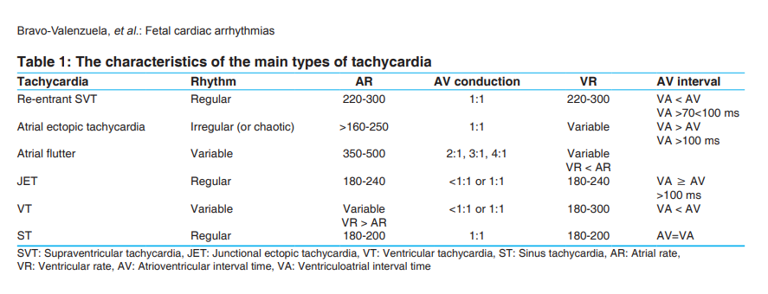

Slide 40
BRADYARRHYTHMIAS
Diagnosis
Fetal bradycardia is defined as an intermittent or persistent fetal heart rate (FHR)<110
FHR 80-120 with normal BTB is normal condition.

Slide 41
Differential diagnosis includes:
Sinus bradycardia
Blocked ectopic beats
Second-degree or third-degree (complete) heart block
Long QT syndrome

Slide 42
Sinus bradycardia
FHR<110 bpm in which the atria and ventricles are beating at the same rate
Brief rates of 100 to 110 bpm are common and physiologic, especially in the second trimester fetus (transient fetal head or umbilical cord compression)
Sustained sinus bradycardia may be associated with structural cardiac anomalies, heterotaxy, or long QT syndrome
Sinus bradycardia can be differentiated from other causes of fetal bradycardia by Doppler or M-mode echocardiography

Slide 43
Differential diagnosis
Structural heart disease – Bradycardia is sometimes seen in fetuses with heterotaxy syndrome
Long QT syndrome
The primary fetal presentations are low FHR , in more severe cases, functional 2:1 atrioventricular block
may have persistent mild bradycardia at rates of 100 to 110 bpm
There is a very high likelihood that a parent is affected
parental phenotype can be mild

Slide 44
Noncardiac conditions
maternal hypotension
maternal seizures
paracervical block anesthesia
impaired fetal oxygenation
placental abruption
uterine rupture
prolapsed umbilical cord
fetal hemorrhage
and fetal hypotension

Slide 45
maternal hypothermia can result in fetal bradycardia and corrects with rewarming
FHR <100bpm, but with normal variability and accelerations
Maternal conditions included urosepsis, hypoglycemia, and drug or cold weather exposure
Fetal bradycardia during cardiopulmonary bypass

Slide 46
Evaluation
Standard ultrasound examination to exclude major heart disease and hydrops fetalis
Biophysical profile to assess fetal well-being
nonstress test is likely to be nonreactive with sustained bradycardias, but variability may be normal
Maternal laboratory testing for anti-Ro/SSA and anti-La/SSB antibodies
complete history of medicinal and recreational drug use, caffeine intake, and signs of hyperthyroidism.
complete family history of prolonged QT syndrome, congenital deafness , previous fetal demise, sudden unexplained death in family members younger than 50 years of age, and tuberous sclerosis.

Slide 47
Management of bradycardia
When you face with abnormal trace :
1- confirm that the monitor is recording FHR and uterine activity adequately
2- assess uterine activity along with baseline FHR, variability, acceleration or …and place the tracing in category I,II,III
3- Bradycardia with poor variability is on category III
4- Bradycardia with other characteristics is on category II

Slide 48
Management – If the standard ultrasound examination is normal:
Intermittent bradycardia <110bpm
Perform FHR checks weekly for a few weeks to make sure that the bradycardia is not becoming sustained
Reassessment for hydrops
referral to a fetal cardiologist are indicated if the intermittent bradycardia persists
Sustained bradycardia <110bpm In consultation with the maternal cardiologist, discontinue any maternal medications that could be impacting corrected QT interval (QTc)

Slide 49
Two important steps in assessing a fetal heart rate <110 are :
Distinguishing a low baseline from prolonged deceleration
Excluding artifact (maternal HR) or arrhythmia

Slide 51
Maternal heart rate artifact
When the fetus is dead uterine electrode that is used for FHR monitoring may be record maternal heart rate
Due to changes in maternal heart rate such as tachycardia or accelerations this pattern may mistaken by normal FHR
In majority of cases in this setting seems that the fetus is bradycardia
Simultaneous maternal and fetal heart rate recording is recommended( by pulse oximetry or specific probe or ultrasound)

Slide 52
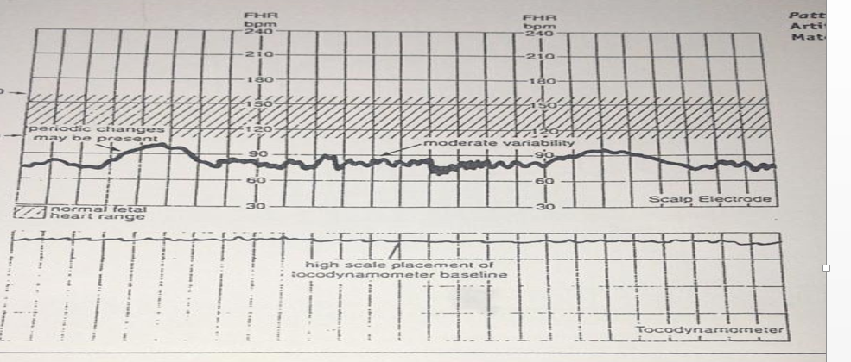

Slide 53
Heart block
Blocked ectopic beats
when PACs occur in bigeminy (or trigeminy) and are consistently blocked, the rhythm will be regular but slow (65 to 90 bpm)
weekly obstetric evaluation to determine the FHR as long as atrial ectopy persists
Second-degree heart block
check anti-Ro/SSA and anti-La/SSB antibodies
Progression to complete heart block is a common outcome
there is often an irregular rhythm at a slow rate with lengthening of the mechanical PR interval from one beat to the next.

Slide 54
Complete (third-degree) heart block
The atrial rate is typically normal
ventricular rate is typically between 50 and 80 bpm
Fifty percent of fetuses have congenital heart disease
exposure to maternal autoantibodies and myocarditis.
heart block is rare before 18 weeks or after 28 weeks.

Slide 55
in women with SLE, Sjögren's syndrome, rheumatoid arthritis, scleroderma, and undifferentiated connective tissue disorders with anti-SS-A/Ro, anti-SS-B/La, or both
Many women carrying a fetus with CAVB do not have symptoms , with half demonstrating only serologic evidence of disease.
The risk of a woman with SS-A/Ro and SS-B/La antibodies and no prior affected infant having a fetus with heart block is 1% to 2%.
The risk of recurrence of CAVB in subsequent pregnancies after delivering an affected infant is 10% to 16%

Slide 56
Management Options for Heart Block
Second-degree AV block (Mobitz type I/Wenckebach): No treatment is necessary in asymptomatic fetuses.
Second-Degree Atrioventricular Block (Mobitz Type II and Advanced Types) Management of these conduction abnormalities is similar to that of complete AV block

Slide 57
Third-Degree or Complete Atrioventicular Block
Maternal or direct fetal administration of sympathomimetic agents such as terbutaline, isoproterenol, and salbutamol have some efficacy in increasing both fetal heart rate and contractility.
transuterine-transthoracic pacing has been reported in a few human fetuses.
Despite technical successes, all reported treated fetuses have died.
Removal of the anti-SS-A/Ro and anti-SS-B/La in a few cases by plasmapheresis with variable results.
Intravenous gammaglobulin has also been reported to reduce the maternal anti-Ro antibody titer.

Slide 58
Fluorinated steroids such as dexamethasone and betamethasone have been used for prevention and treatment of CAVB
Steroids administered shortly after the onset of early AV block (second-degree) may have reversed the block or prevented its advancement in at least some fetuses.
Although steroids will not reverse CAVB, they may ameliorate myocardial inflammation and dysfunction and help optimize fetal cardiac output.

Slide 59
MANAGEMENT OF LABOR AND DELIVERY
fetus with arrhythmia can undergo labor and vaginal delivery as long as fetal well-being can be monitored
Fetuses with intermittent arrhythmias may display a normal fetal heart rate (FHR) pattern frequently
If fetal wellbeing cannot be evaluated adequately, then cesarean delivery is the best option

